Slide 1



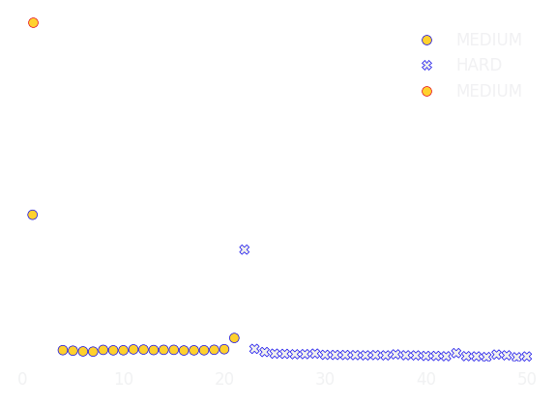

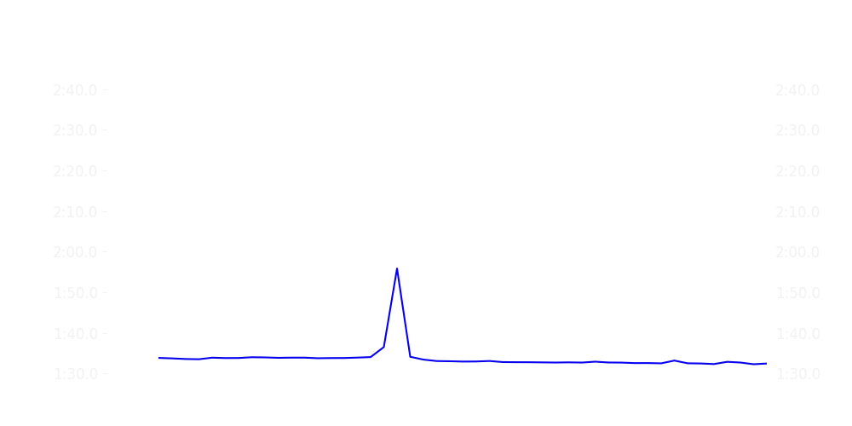
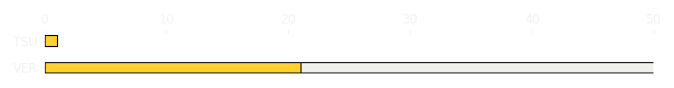
Saudi GP Race
Driver
Race Time
Race Time
Driver
Max Verstappen
1:19:06.294
0:00
Yuki Tsunoda
Avg Lap Time
1:33.073
IQR
Gap
Gap
IQR
Avg Lap Time
1.13 s
-49 laps
+49 laps
0.0 s
2:45.662
Race Comparaison
Race Comparaison
Lap Advantage
47/50
Position
2
Safety Car Lap
3/50
Position
20
Lap Advantage
0/50
Lap Time Per Lap
Lap Time Per Lap
Tyre Strategy
Total Pit Stop Time
00:26.030 s
Pit Stops
1
Pit Stops
0
Total Pit Stop Time
0:00:00
Tyre Strategy

Slide 2


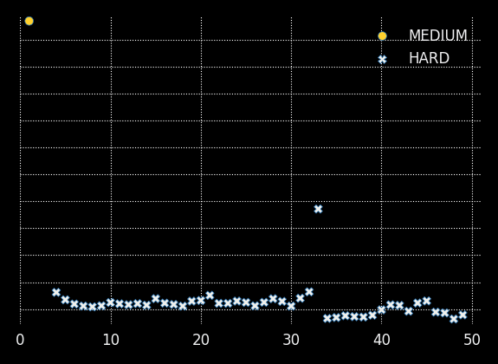

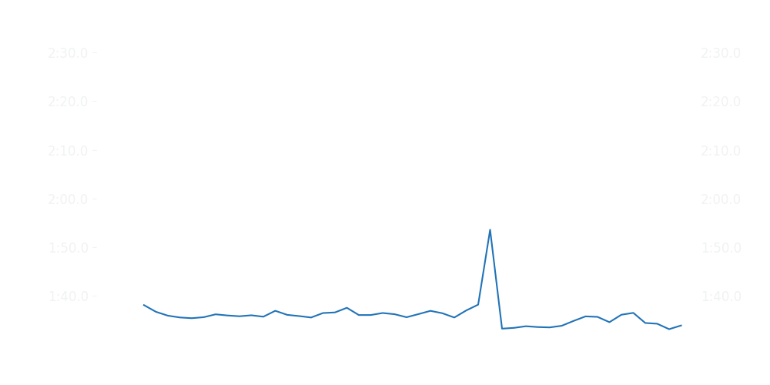
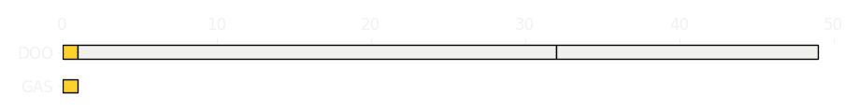
Saudi GP Race
Driver
Race Time
Race Time
Driver
Pierre Gasly
0
1:11:58.923
Jack Doohan
Avg Lap Time
0
IQR
Gap
Gap
IQR
Avg Lap Time
0
+48 laps
-48 laps
1.465 s
1:35.885
Race Comparaison
Race Comparaison
Lap Advantage
0/49
Position
DNF
Safety Car Lap
3/49
Position
17
Lap Advantage
46/49
Lap Time Per Lap
Lap Time Per Lap
Tyre Strategy
Total Pit Stop Time
0:00:00
Pit Stops
0
Pit Stops
2
Total Pit Stop Time
00:42.092 s
Tyre Strategy

Slide 3


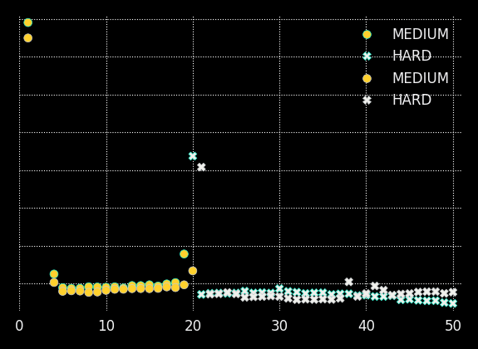

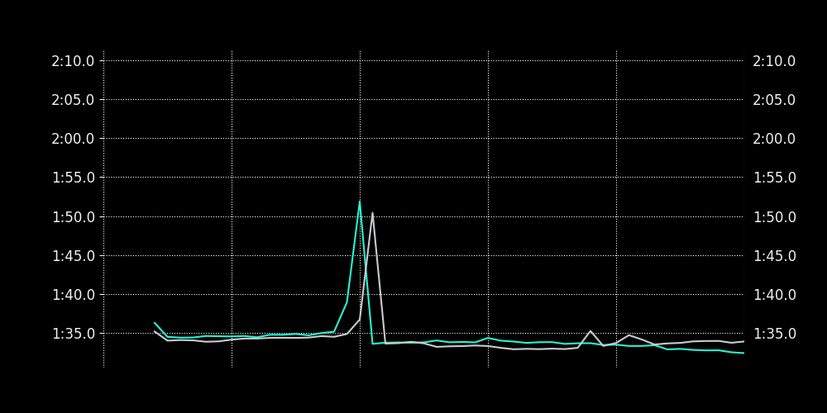
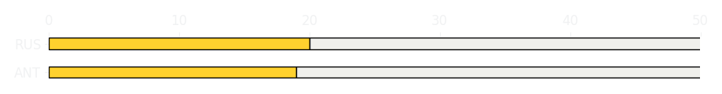
Saudi GP Race
Driver
Race Time
Race Time
Driver
Kimi Antonelli
1:19:32.104
1:19:26.684
George Russell
Avg Lap Time
1:33.804
IQR
Gap
Gap
IQR
Avg Lap Time
1.017 s
+07.463 s
-07.463 s
0.992 s
1:33.897
Race Comparaison
Race Comparaison
Lap Advantage
14/50
Position
6
Safety Car Lap
3/50
Position
5
Lap Advantage
33/50
Lap Time Per Lap
Lap Time Per Lap
Tyre Strategy
Total Pit Stop Time
00:20.399 s
Pit Stops
1
Pit Stops
1
Total Pit Stop Time
00:20.329 s
Tyre Strategy

Slide 4


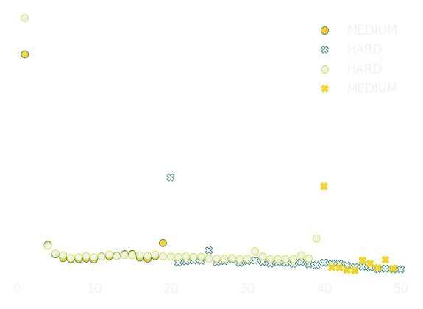

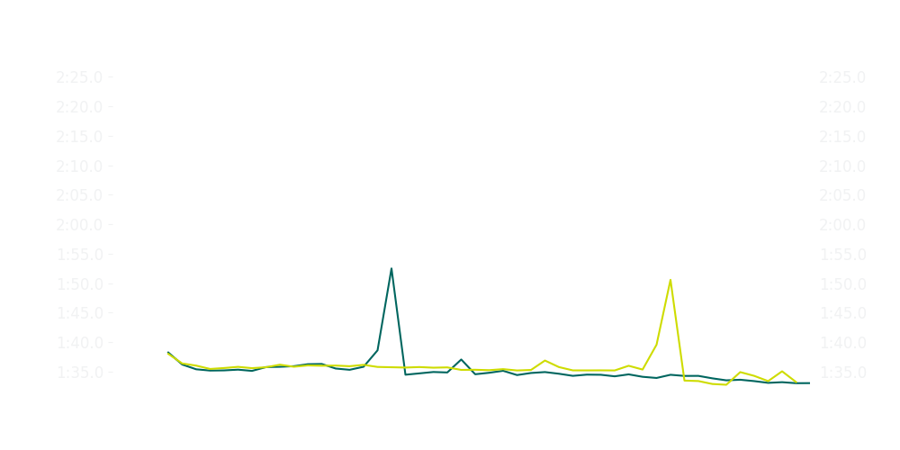
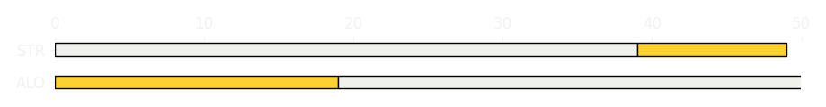
Saudi GP Race
Driver
Race Time
Race Time
Driver
Fernando Alonso
1:12:58.147
1:11:46.115
Lance Stroll
Avg Lap Time
1:34.741
IQR
Gap
Gap
IQR
Avg Lap Time
1.186 s
-1 laps
+1 laps
0.766 s
1:35.614
Race Comparaison
Race Comparaison
Lap Advantage
35/50
Position
12
Safety Car Lap
3/50
Position
16
Lap Advantage
12/50
Lap Time Per Lap
Lap Time Per Lap
Tyre Strategy
Total Pit Stop Time
00:21.891 s
Pit Stops
1
Pit Stops
1
Total Pit Stop Time
00:20.487 s
Tyre Strategy

Slide 5

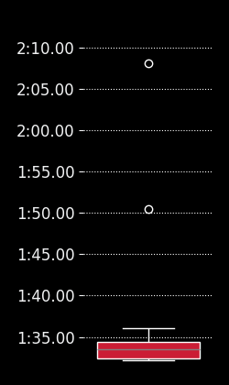
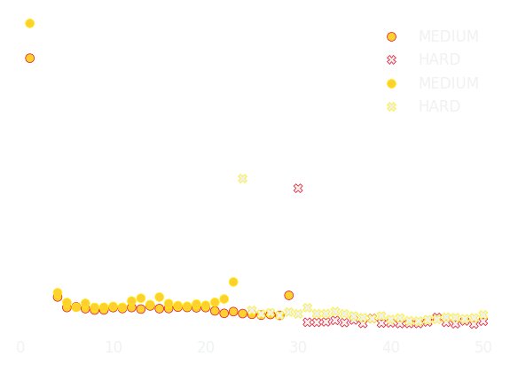
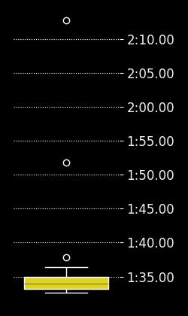
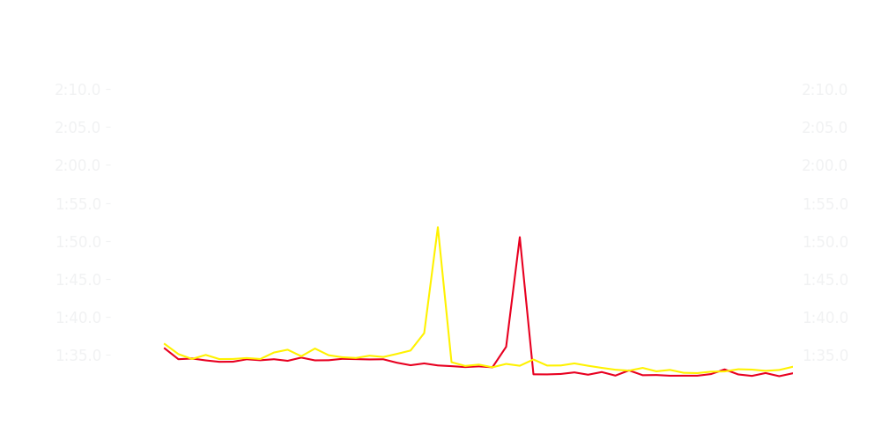
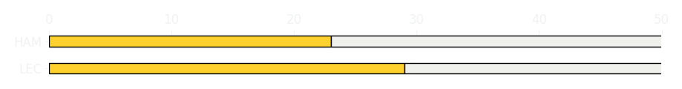
Saudi GP Race
Driver
Race Time
Race Time
Driver
Charles Leclerc
1:19:06.968
1:12:24.170
Lewis Hamilton
Avg Lap Time
1:33.560
IQR
Gap
Gap
IQR
Avg Lap Time
1.938 s
-31.096 s
+31.096 s
1.659 s
1:33.876
Race Comparaison
Race Comparaison
Lap Advantage
41/50
Position
3
Safety Car Lap
3/50
Position
7
Lap Advantage
6/50
Lap Time Per Lap
Lap Time Per Lap
Tyre Strategy
Total Pit Stop Time
00:20.131 s
Pit Stops
1
Pit Stops
1
Total Pit Stop Time
00:20.144 s
Tyre Strategy

Slide 6


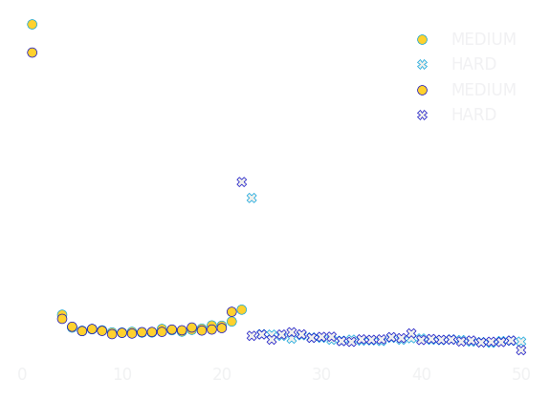

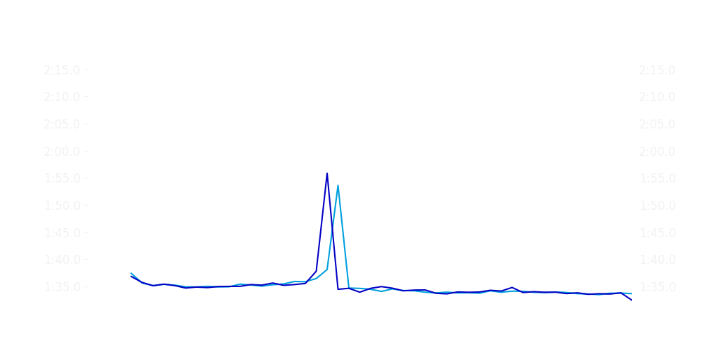
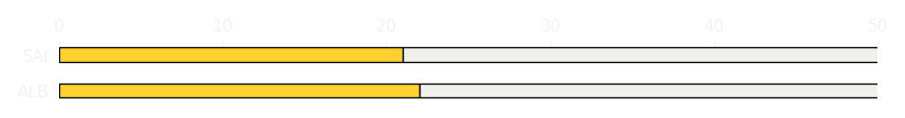
Saudi GP Race
Driver
Race Time
Race Time
Driver
Alexander Albon
1:12:49.803
1:12:49.183
Carlos Sainz
Avg Lap Time
1:34.460
IQR
Gap
Gap
IQR
Avg Lap Time
1.346 s
+01.887 s
-01.887 s
1.211 s
1:34.632
Race Comparaison
Race Comparaison
Lap Advantage
25/50
Position
9
Safety Car Lap
3/50
Position
8
Lap Advantage
22/50
Lap Time Per Lap
Lap Time Per Lap
Tyre Strategy
Total Pit Stop Time
00:22.135 s
Pit Stops
1
Pit Stops
1
Total Pit Stop Time
00:24.148 s
Tyre Strategy

Slide 7


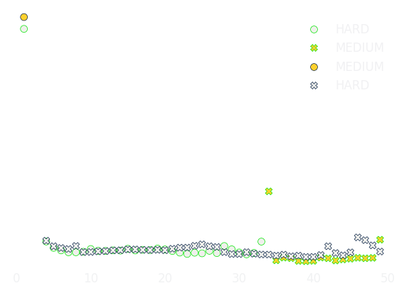

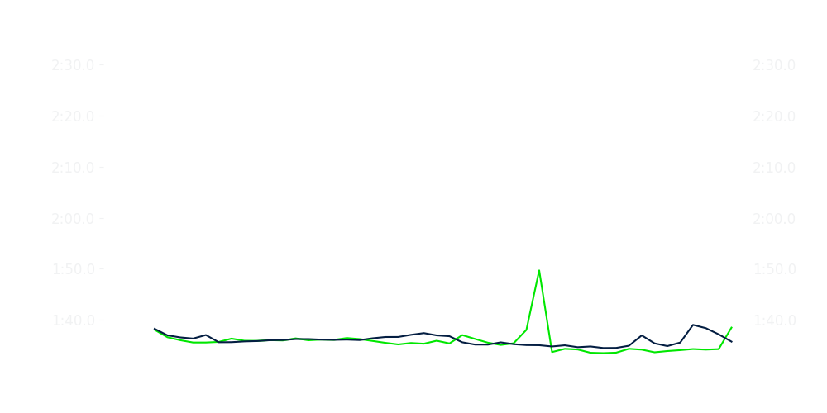
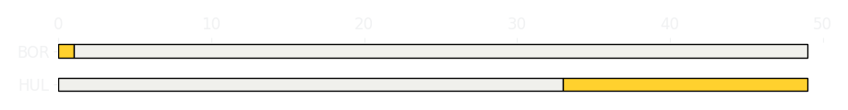
Saudi GP Race
Driver
Race Time
Race Time
Driver
Nico Hulkenberg
1:11:44.850
1:11:57.929
Gabriel Bortoleto
Avg Lap Time
1:35.524
IQR
Gap
Gap
IQR
Avg Lap Time
1.83 s
-14.731 s
+14.731 s
1.475 s
1:35.988
Race Comparaison
Race Comparaison
Lap Advantage
29/49
Position
15
Safety Car Lap
3/49
Position
18
Lap Advantage
17/49
Lap Time Per Lap
Lap Time Per Lap
Tyre Strategy
Total Pit Stop Time
00:20.441 s
Pit Stops
1
Pit Stops
1
Total Pit Stop Time
00:21.854 s
Tyre Strategy

Slide 8


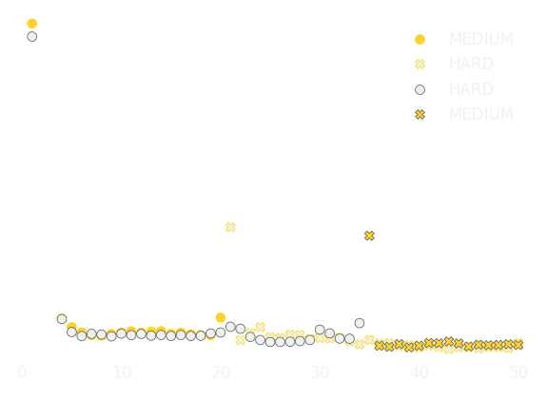

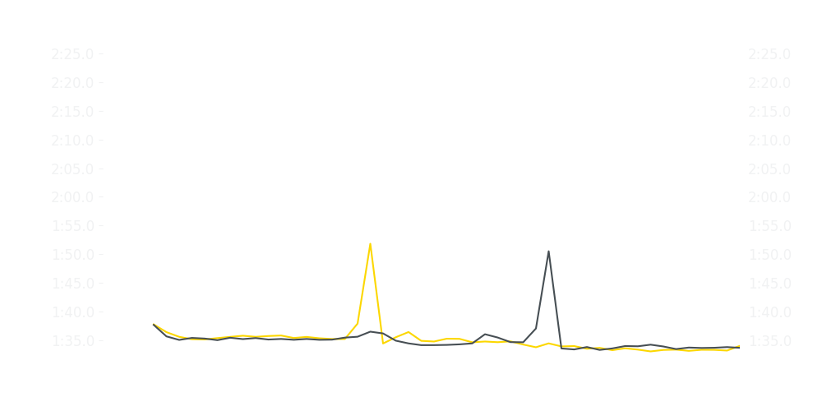
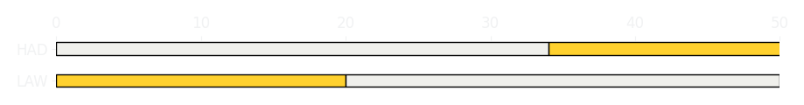
Saudi GP Race
Driver
Race Time
Race Time
Driver
Liam Lawson
1:12:50.323
1:12:49.402
Isack Hadjar
Avg Lap Time
1:34.755
IQR
Gap
Gap
IQR
Avg Lap Time
1.829 s
+01.367 s
-01.367 s
1.466 s
1:34.873
Race Comparaison
Race Comparaison
Lap Advantage
20/50
Position
11
Safety Car Lap
3/50
Position
10
Lap Advantage
27/50
Lap Time Per Lap
Lap Time Per Lap
Tyre Strategy
Total Pit Stop Time
00:20.534 s
Pit Stops
1
Pit Stops
1
Total Pit Stop Time
00:20.827 s
Tyre Strategy

Slide 9


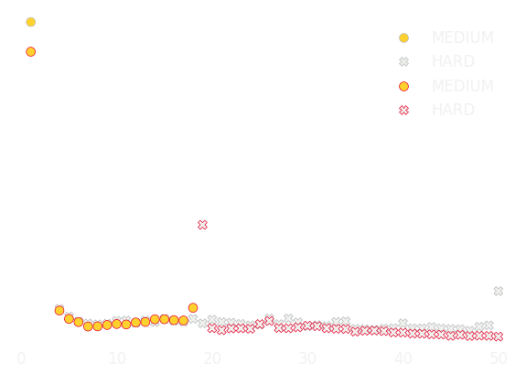

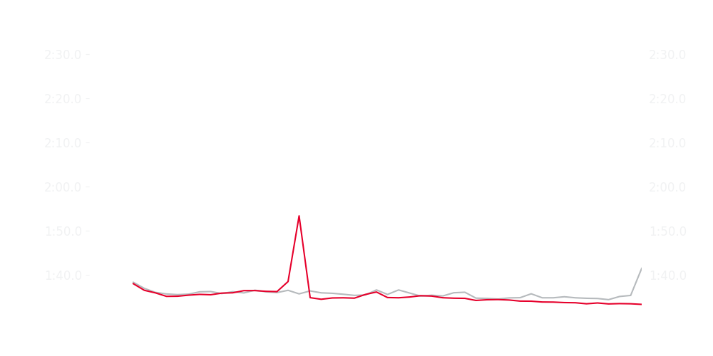
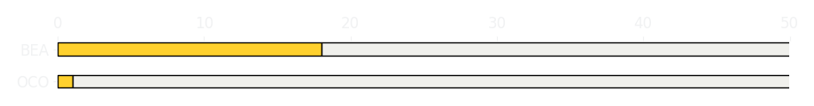
Saudi GP Race
Driver
Race Time
Race Time
Driver
Esteban Ocon
1:13:18.819
1:13:00.595
Ollie Bearman
Avg Lap Time
1:35.602
IQR
Gap
Gap
IQR
Avg Lap Time
1.037 s
+20.475 s
-20.475 s
1.59 s
1:34.743
Race Comparaison
Race Comparaison
Lap Advantage
8/50
Position
14
Safety Car Lap
3/50
Position
13
Lap Advantage
39/50
Lap Time Per Lap
Lap Time Per Lap
Tyre Strategy
Total Pit Stop Time
00:21.512 s
Pit Stops
1
Pit Stops
1
Total Pit Stop Time
00:22.095 s
Tyre Strategy

Slide 10


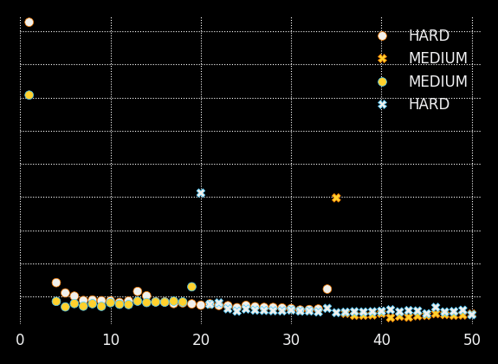

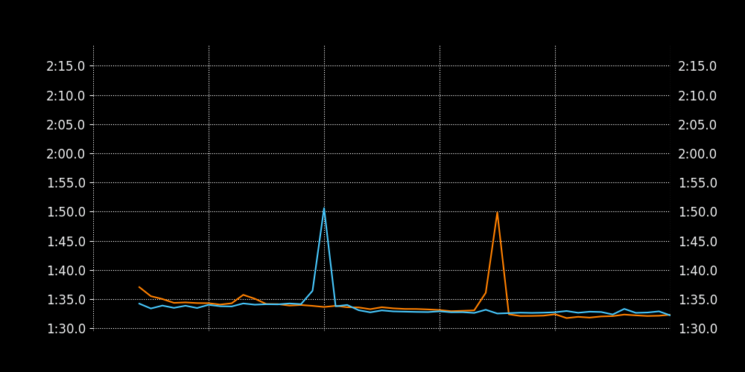
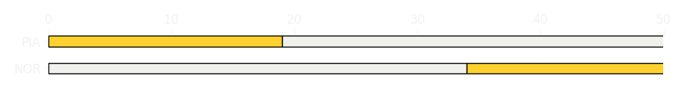
Saudi GP Race
Driver
Race Time
Race Time
Driver
Lando Norris
1:11:53.186
1:19:01.678
Oscar Piastri
Avg Lap Time
1:33.443
IQR
Gap
Gap
IQR
Avg Lap Time
1.885 s
+09.179 s
-09.179 s
1.173 s
1:33.039
Race Comparaison
Race Comparaison
Lap Advantage
19/50
Position
4
Safety Car Lap
3/50
Position
1
Lap Advantage
28/50
Lap Time Per Lap
Lap Time Per Lap
Tyre Strategy
Total Pit Stop Time
00:20.427 s
Pit Stops
1
Pit Stops
1
Total Pit Stop Time
00:21.388 s
Tyre Strategy

